Slide 1
Programming in unity

Slide 2
Variables and types
Different types
String = “This is a string” (Just a bunch of letters in one place)
Int = 24 (Ints are whole numbers, negative or positive)
Float = 24.0f (Decimal point numbers)
Declared like this:
int age = 22;
Variable type
Semicolon marks the end of a statement
Name of our variable
The value we declare

Slide 3
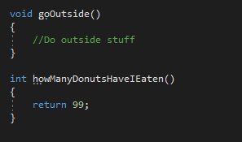
functions
Functions make the game go round!
We can declare a function anywhere within our class, and there are a few different parts:
Private void myFunction()
{
// This is a comment
}
This is an access modifier.
Modifiers include private, protected, and public
Parentheses are our parameter list.
The value we want to return. Sometimes void, sometimes not.
The name of our function.
Comments are declared with // wherever you want to make a comment.
Curly braces mark the body of a function.

Slide 4
Unity functions
Awake() -
Start() -
Update() -
FixedUpdate() -

Slide 5
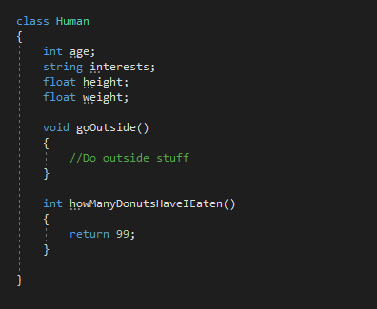
classes
Very important
A class can be anything, including you!
Can contain a bunch of information about a ton of stuff
Made with the ‘class’ keyword
Usually contains variables, functions, and more!

Slide 6
Using functions within a class

Slide 7
Unity classes
We have specific classes that are used in Unity to make games:
SpriteRenderer – These are used to display images of GameObjects we have in our scene in 2D.
Rigidbody2D – This gives our GameObjects physics capabilities in 2D.
Transform – Comes with every GameObject, and defines the , , and scale of something.
Animator – Controls most aspects of animation that a GameObject uses such as states, transitions, and what animations to play at certain times.
position
rotation

